Slide 1


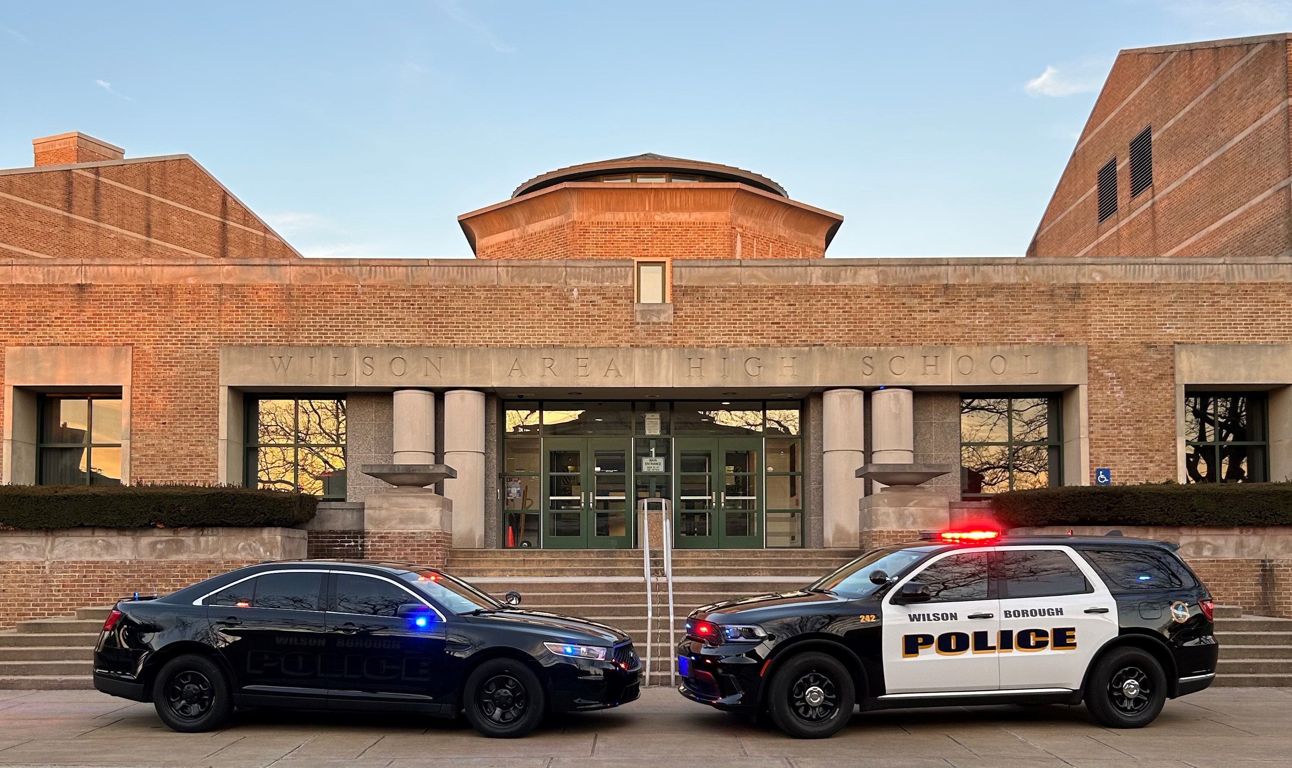
Wilson Borough Police Immediate Vacancies Testing Soon
Want To Work In A Department Where You Can Make A Difference? Here’s What Wilson Borough Can Offer You:
MPOETC Academy Reimbursement up to $6,000
Salary/Medical Benefits For Those Still In The Academy
Hourly Compensation For Those Who Recently Graduated The Academy Up To $22,975
Starting Salary $61,437, reach top salary in just 3 years, expected $90,000 +
12 Hour Shifts, Work Approx. 180 Days Per Year Not Including Vacation And Kelly Time
Longevity After 5 Years
Specialty Units: K9, CID, County Task Force, Bomb Squad, Bike Patrol
Construction Of A New Police Facility
$5,000 Sign On Bonus For Those With Prior LE Experience
https://www.wilsonborough.org/home/employment-opportunities/

